Slide 1
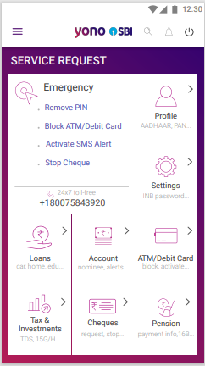
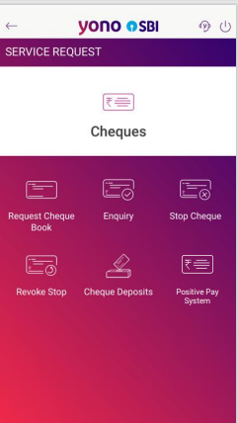
REGISTRATION
User clicks ‘Positive Payment System’ option
User clicks ‘Cheques’ option

Slide 2
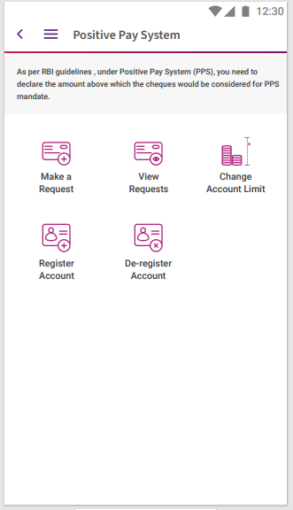
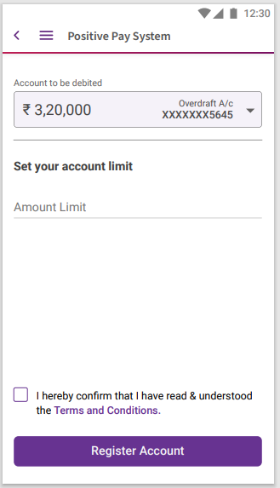
User can select the account by clicking the drop box
User enters the amount beyond which the PPS will be applicable
User can view Terms & Conditions
User clicks ‘Register Account’
After reading the T&C and ticking the check box , user selects Register Account

Slide 3
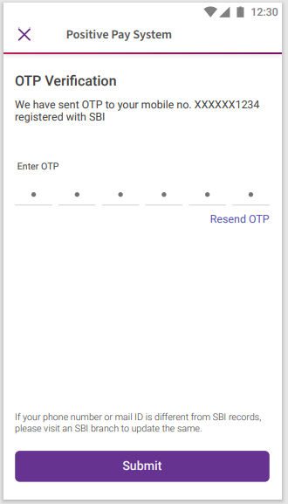
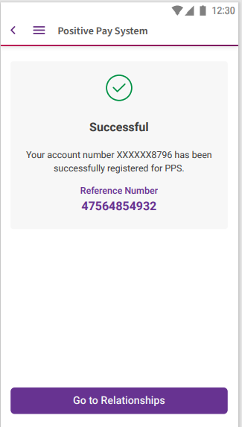
After clicking Register Account , OTP is sent to bank registered mobile no.
User enters the OTP and clicks submit
The Positive Payment Request is raised successfully.

Slide 4
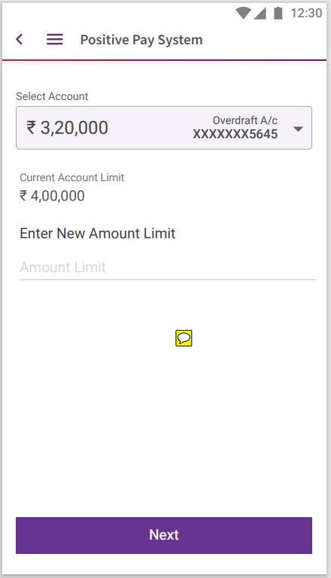
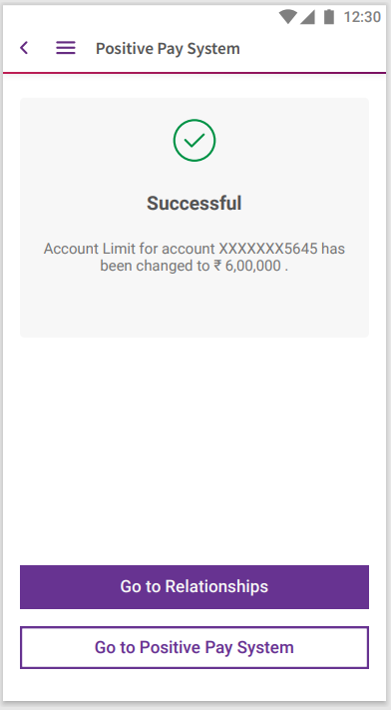

CHANGE LIMIT
User clicks ‘Change Account Limit’
User enters new limit

Slide 5
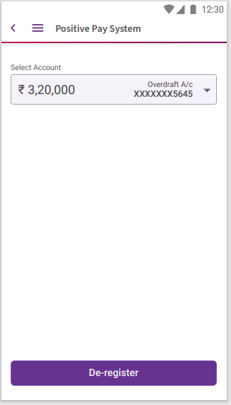
DE-REGISTRATION
User selects the account using dropdown.
User clicks ‘De-register Account’
User clicks ‘De-register’

Slide 6
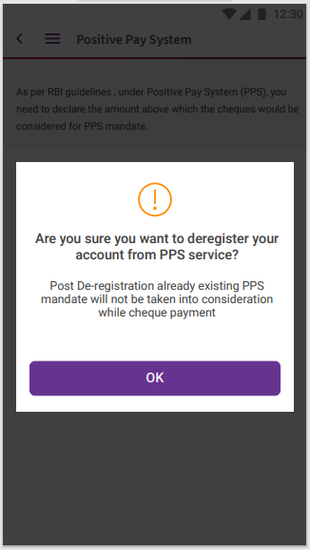
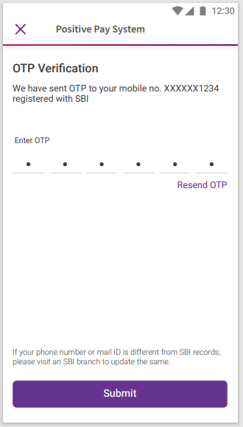
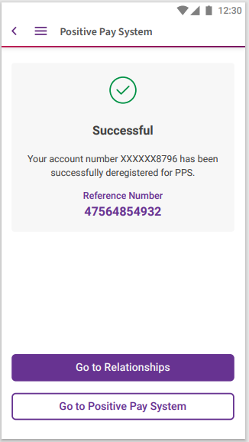
User shown warning pop-up message
OTP authentication takes place

Slide 7
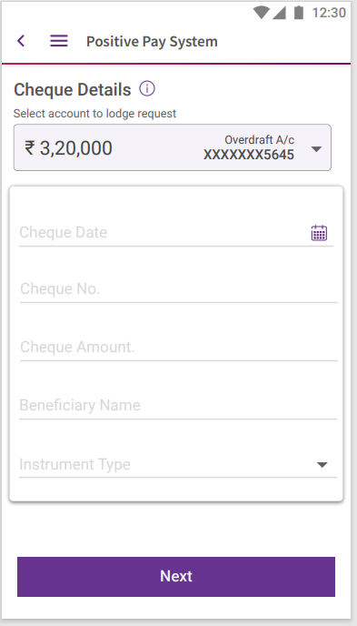
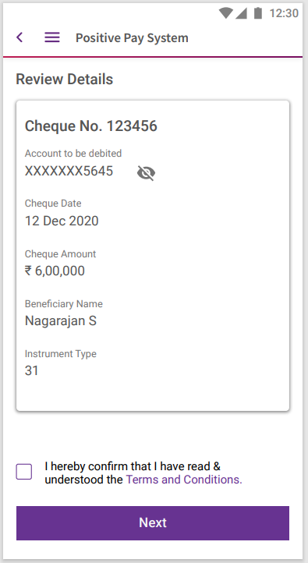
REQUEST LODGEMENT
User enters details account no. , amount, date , beneficiary name, cheque no. and instrument type
After reviewing and reading the T&C , user ticks the checkbox and clicks next
User clicks ‘Make a request’

Slide 8
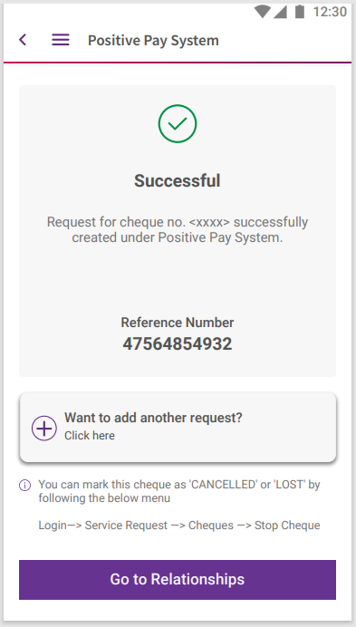
OTP Authentication
Success message

Slide 9
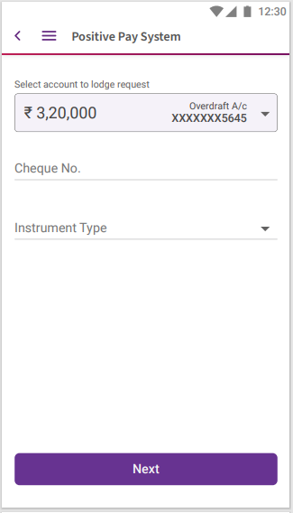
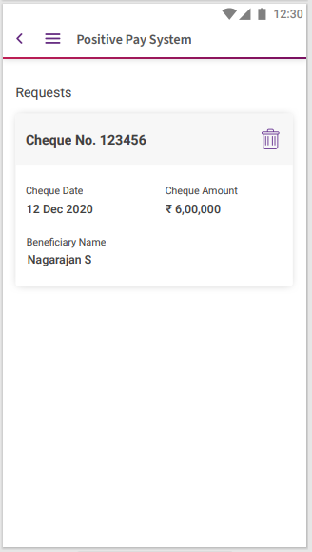
DELETE REQUEST
User clicks ‘View Request’
User enters the required details
User clicks delete icon to delete the request

Slide 10
